Slide 1
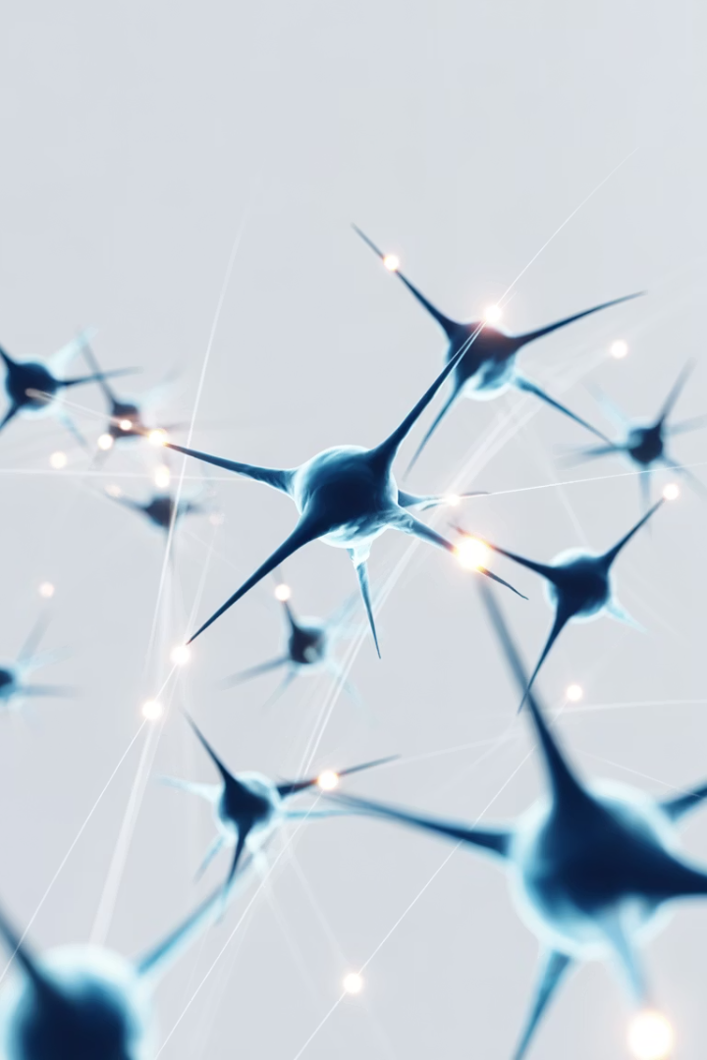

Artificial Neural Networks and Their Applications
Artificial Neural Networks (ANNs) are computing systems inspired by the biological neural networks that constitute animal brains. These sophisticated systems learn to perform tasks by considering examples, generally without being programmed with task-specific rules. As we explore the fascinating world of neural networks, we'll discover how they mimic the human brain and revolutionize various industries through their remarkable capabilities.
Muhammad Saeed

Slide 2
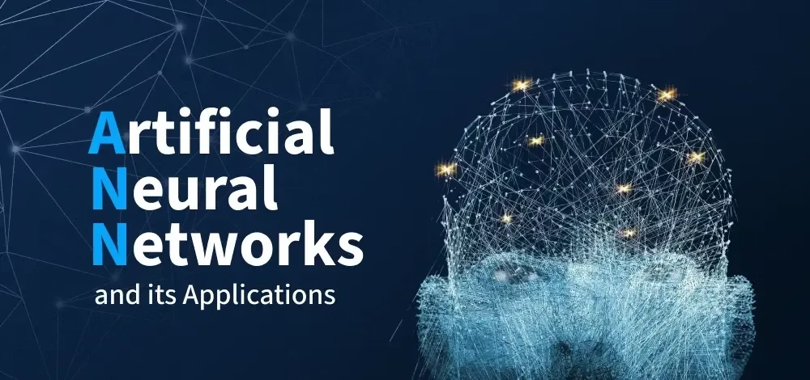
Understanding the Human Brain
Structure
Function
The human brain contains billions of neurons that receive sensory input, process information, and provide output. These neurons are connected to other neurons in complex arrangements at synapses, forming the foundation of our cognitive abilities.
Neurons communicate through electrical impulses and chemical signals. When a neuron receives enough stimulation, it fires an action potential that travels down its axon to communicate with other neurons, enabling thought processes.

Slide 3
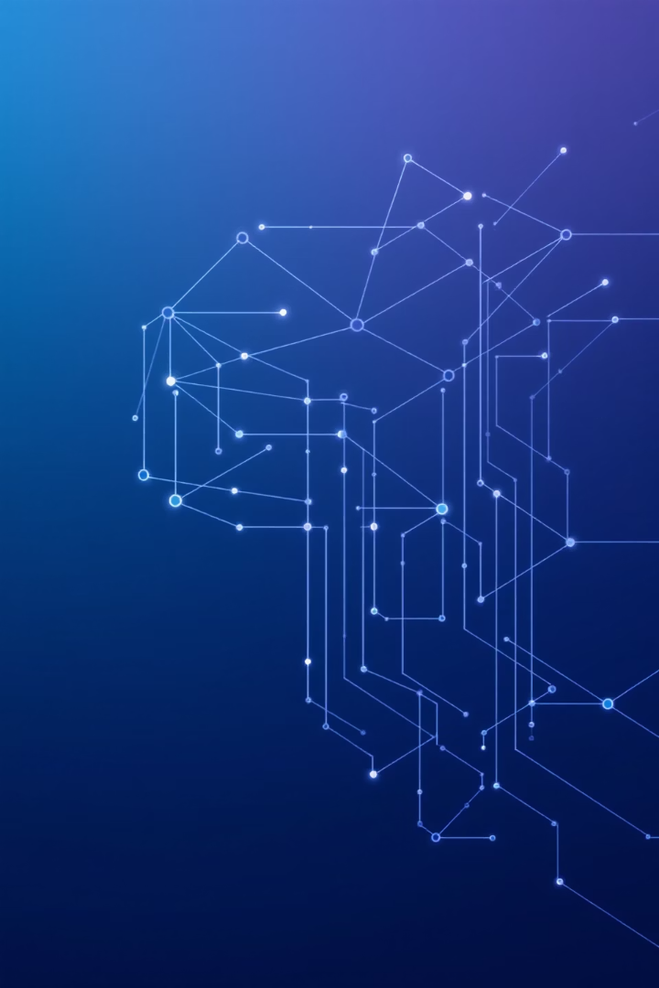



What Are Artificial Neural Networks?
Artificial Units
Layer Structure
ANNs contain artificial neurons called units, arranged in layers that together constitute the whole network system.
A typical ANN has an input layer that receives data, hidden layers that transform the input, and an output layer that provides the response.
Weighted Connections
Units are interconnected from one layer to another, with each connection having weights that determine the influence of one unit on another.

Slide 4

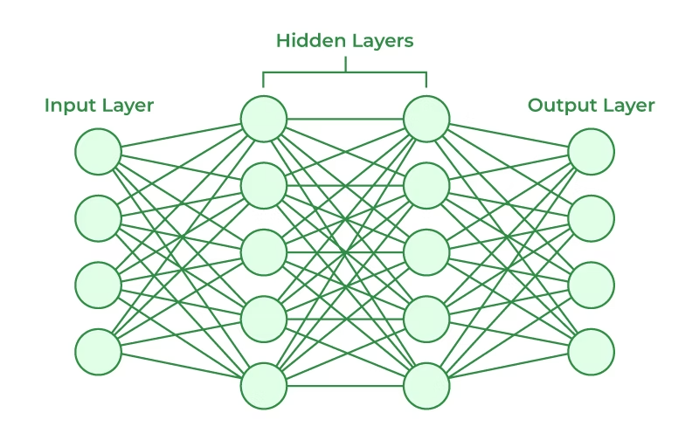



Neural Network Architecture
Input Layer
Receives data from external sources
Hidden Layer
Processes inputs using weighted connections
Output Layer
Provides the final response of the network

Slide 5
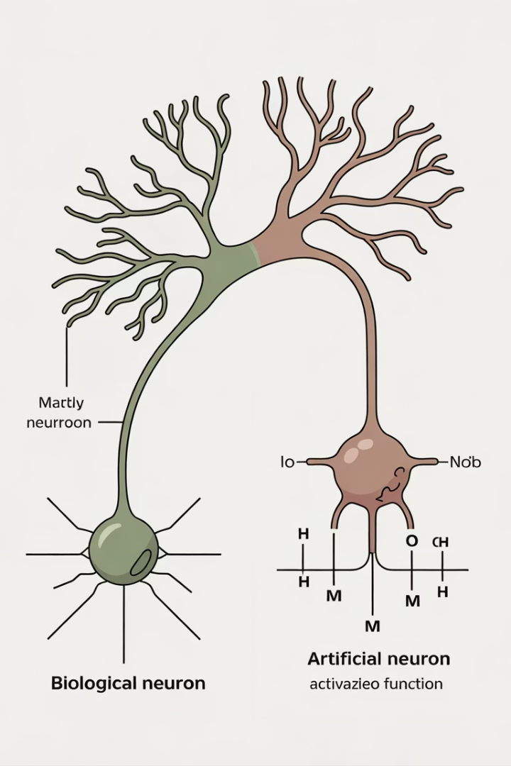
Biological vs. Artificial Neurons
Biological Component
Artificial Equivalent
Dendrites
Inputs
Cell nucleus/Soma
Nodes
Synapses
Weights
Axon
Output
Synaptic plasticity
Backpropagation

Slide 6
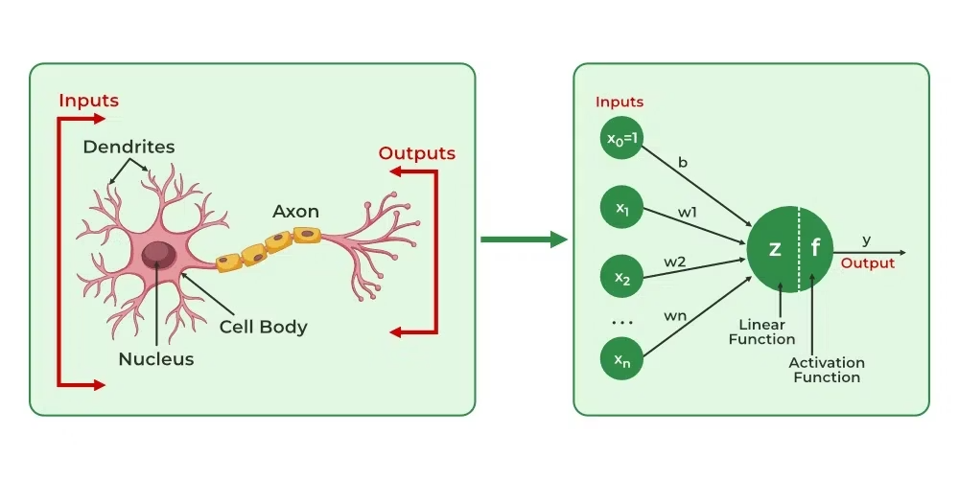
Structure Comparison
Biological Neurons
Artificial Neurons
A biological neuron has a cell body (soma) to process impulses, dendrites to receive them, and an axon that transfers them to other neurons. Learning occurs in the cell body nucleus, which processes impulses and produces action potentials when stimuli reach the threshold.
The input nodes of artificial neural networks receive input signals, the hidden layer nodes compute these signals, and the output layer nodes compute the final output using activation functions. Learning happens through backpropagation, which adjusts weights between nodes based on error rates.

Slide 7
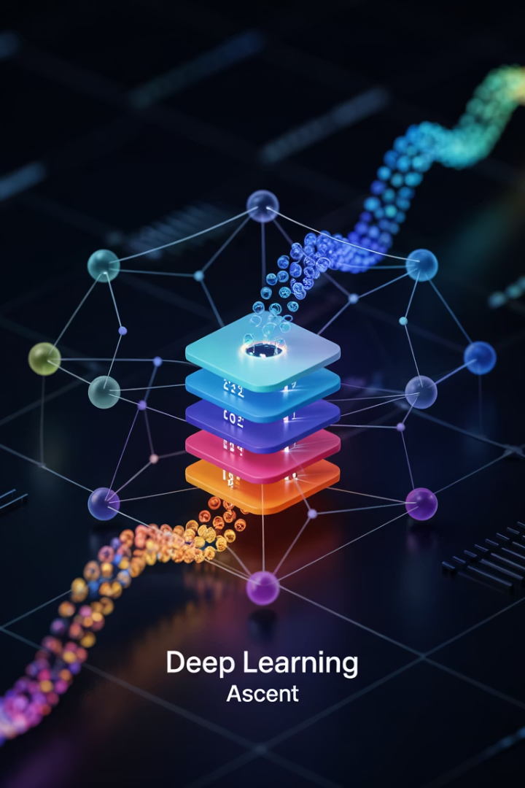
How Artificial Neural Networks Learn
Training Data Input
ANNs are trained using a training set of data. For example, to teach an ANN to recognize cats, it is shown thousands of different cat images to learn identification patterns.
Pattern Recognition
The network processes the training data, adjusting internal parameters to recognize patterns and features characteristic of the subject (e.g., cat features).
Testing & Validation
Once trained, the ANN is tested with new images to see if it can correctly identify cats. The output is compared with human-provided descriptions to verify accuracy.
Backpropagation
If identification errors occur, backpropagation fine-tunes the weights of connections based on the error rate, improving performance until the ANN achieves minimal error rates.

Slide 8
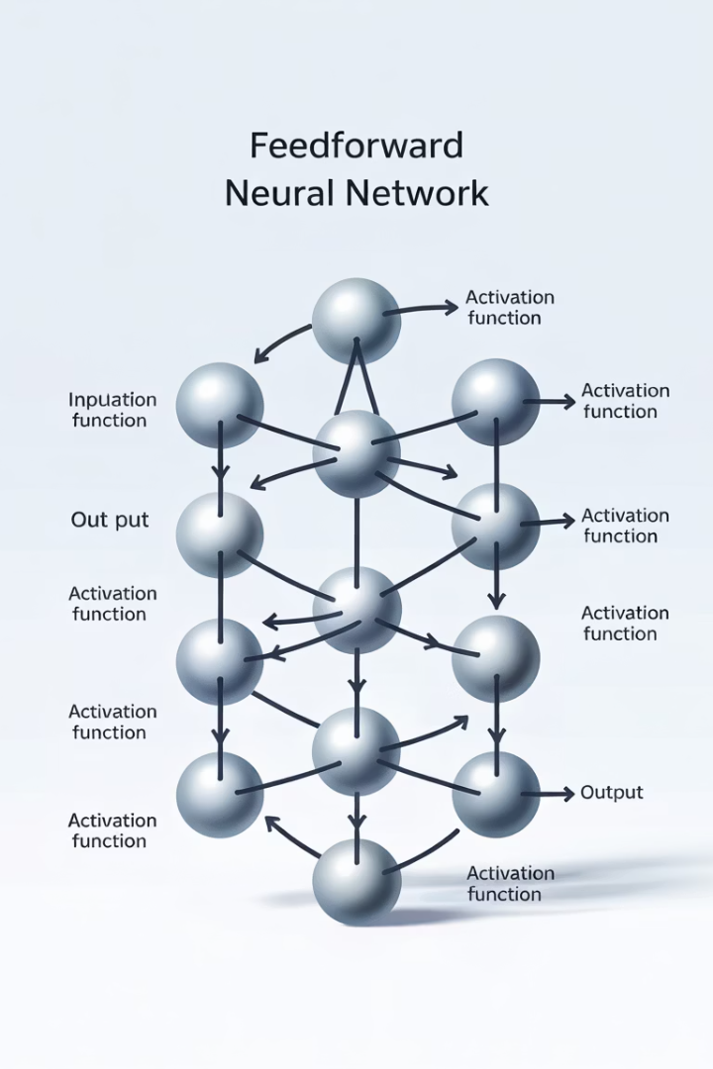
Types of Neural Networks: Feedforward
Structure
Data Flow
One of the most basic ANNs where data travels in a single direction - from input through hidden layers (if any) to output, with no backpropagation.
Information moves forward only, entering through the input layer and exiting through the output layer.
Applications
Used in simple pattern recognition tasks, classification problems, and as building blocks for more complex neural network architectures.

Slide 9








Types of Neural Networks: Convolutional
Input Layer
Receives raw image data
Convolutional Layers
Apply filters to detect features
Pooling Layers
Reduce dimensions while preserving features
Fully Connected Layers
Classify based on extracted features
Convolutional Neural Networks (CNNs) are similar to feedforward networks but include convolutional layers that use a convolution operation on input data. CNNs excel at processing grid-like data such as images, making them particularly valuable for computer vision applications and image recognition tasks.

Slide 10








Types of Neural Networks: Recurrent
Memory Storage
Input Processing
Retains information from previous steps
Receives sequential data input
Output Generation
Computation
Produces output that feeds back into the system
Processes current input with stored memory
Recurrent Neural Networks (RNNs) save the output of a layer and feed this back to the input to better predict outcomes. This creates a form of memory that allows RNNs to excel at processing sequential data like text, speech, or time series data where context matters.

Slide 11
Other Neural Network Types
Modular Neural Network
Radial Basis Function Network
Contains a collection of different neural networks working independently toward obtaining output with no interaction between them. Each network performs a different sub-task by obtaining unique inputs, breaking down complex computational processes into smaller components.
Uses radial basis functions that consider the distance of a point concerning the center. These networks have two layers: the first maps input into all radial basis functions in the hidden layer, and the output layer computes the final result. They excel at modeling data with underlying trends.

Slide 12


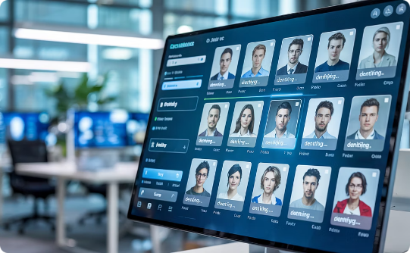
Application: Social Media
Friend Suggestions
Content Recommendations
Facial Recognition
Facebook's "People You May Know" feature uses neural networks to analyze your profile, interests, current friends, and their connections to suggest potential contacts you might know in real life.
Neural networks analyze your browsing history, likes, and engagement patterns to recommend content that matches your interests, keeping you engaged on the platform longer.
Social platforms use neural networks for facial recognition to suggest tags for people in your photos, enhancing the social connection experience.

Slide 13




Application: Marketing and Sales
E-commerce platforms like Amazon use neural networks to recommend products based on your browsing history and purchase patterns. Similarly, food delivery apps like Zomato and Swiggy suggest restaurants based on your tastes and previous orders. This personalized marketing extends across book sites, movie services, and hospitality platforms, creating tailored user experiences that drive sales.

Slide 14




Application: Healthcare
Cancer Detection
Rare Disease Identification
Neural networks are trained to identify cancerous tissue at the microscopic level with accuracy comparable to trained physicians, enabling earlier diagnosis and treatment.
Facial analysis powered by neural networks can identify subtle physical characteristics that may indicate rare diseases in their premature stages, allowing for earlier intervention.
Patient Monitoring
Neural networks analyze patient data in real-time to predict potential health issues before they become critical, improving preventative care.

Slide 15



Application: Personal Assistants
Speech Recognition
Convert spoken language to text
Natural Language Processing
Understand meaning and context
Response Generation
Formulate appropriate answers
Personal assistants like Alexa, Siri, and Google Assistant use Natural Language Processing powered by neural networks to interact with users naturally. These systems manage language syntax, semantics, speech correction, and conversation flow, creating an intuitive user experience that feels like talking to a human assistant rather than a machine.

Slide 16
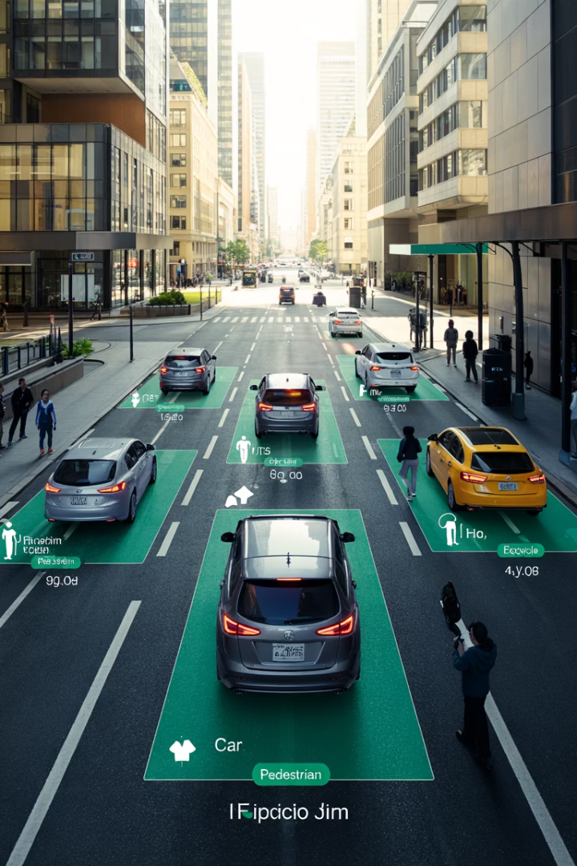
Application: Computer Vision
Object Detection
Image Classification
Neural networks can identify and locate multiple objects within images or video streams, enabling applications from autonomous vehicles to security surveillance systems.
Systems can categorize images into thousands of different classes with high accuracy, powering photo organization tools and content moderation systems.
Facial Recognition
Advanced neural networks can identify individuals from facial features, enabling security applications and personalized experiences across devices.

Slide 17





Application: Natural Language Processing
Text Analysis
Neural networks process and understand written text, extracting meaning, sentiment, and key information.
Translation
Systems like Google Translate use neural networks to provide increasingly accurate translations between hundreds of languages.
Chatbots
Intelligent conversational agents use neural networks to understand queries and generate human-like responses.
Content Generation
Advanced models can create coherent articles, stories, and other text content based on prompts or requirements.

Slide 18





Application: Financial Services
Market Prediction
Fraud Detection
Credit Scoring
Neural networks analyze market trends and historical data to forecast stock prices and market movements.
Advanced systems identify unusual patterns in transaction data to flag potential fraudulent activities.
Neural networks assess creditworthiness by analyzing various factors beyond traditional credit history.
Algorithmic Trading
Automated systems execute trades at optimal times based on neural network analysis.

Slide 19








Challenges and Limitations
Data Requirements
Computational Intensity
Neural networks typically require large amounts of high-quality training data to perform effectively.
Training complex neural networks demands significant computational resources and energy.
Ethical Concerns
Black Box Problem
Applications raise questions about privacy, bias, and the societal impact of AI systems.
The decision-making process of neural networks can be difficult to interpret or explain.

Slide 20

The Future of Neural Networks
100x
10B+
Efficiency Gains
Parameters
Next-generation neural networks may achieve similar results with a fraction of the computational resources.
Larger models with billions of parameters will tackle increasingly complex problems.
$15.7T
Economic Impact
Projected global economic impact of AI by 2030, with neural networks playing a central role.
As neural network technology continues to advance, we can expect more sophisticated applications across industries. Improvements in interpretability will address the black box problem, while energy-efficient architectures will make deployment more sustainable. The integration of neural networks with other AI techniques will create hybrid systems with enhanced capabilities, opening new frontiers in artificial intelligence.

